Slide 1

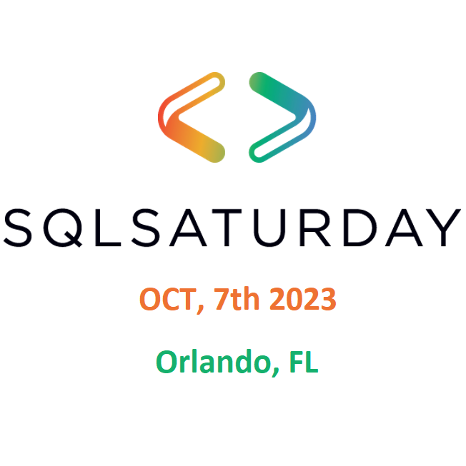


Slide 2


















Thank you, Sponsors!
Join Our Local User Groups:

Slide 3
Let’s Dance – Migrate SQL Server to Managed Instance in 60 Minutes or Less
Daniel Taylor

Slide 4

Daniel Taylor, Microsoft
Sr. Azure FastTrack CXP Engineer
Started as Sybase ASE / IQ DBA
SQL Server 2000 and beyond
Proud Geek, Video Gamer, and lover of the mountains
@dbabulldog
datay@microsoft.com
https://github.com/TalesFromTheField/Team-Presentation/tree/2e1adac68fac07a27137fc184c10844419c7cc8d/2023_SQL_Sat_Orlando/DanTaylor_ADS_Migration_Extension

Slide 5
Karthik Yella, Microsoft
Sr. Azure FastTrack CXP Engineer
SQL Server 2000 and Beyond
Sports Fanatic
@karthik_yv
vyella@microsoft.com
https://github.com/dbabulldog-repo/SharedPresentations.git

Slide 6


Slide 7

Our journey to Azure SQL DB / Managed Instance
Pre-Migration
Migration
Post-Migration

Slide 8
Pre-Migration

Slide 9
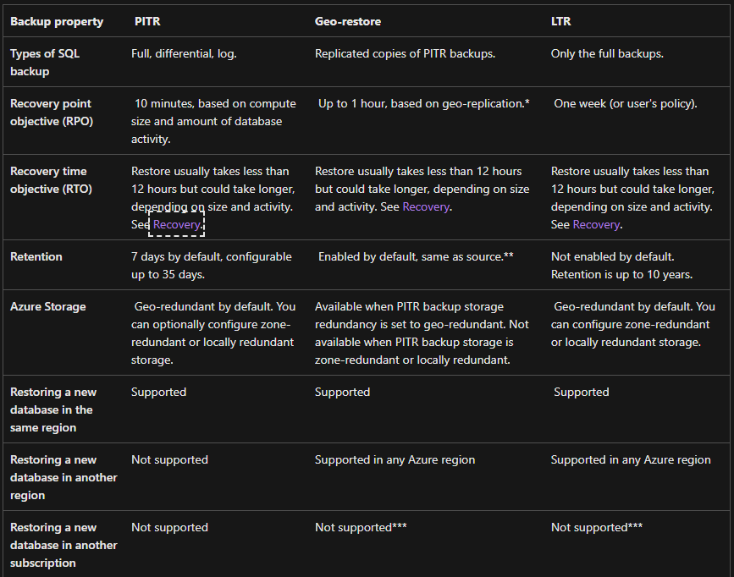
Things we should consider
Current and Expected size of Database
Performance considerations / Workload
SLA / RPO / RTO
BCDR considerations
Instance / Database dependencies
https://bit.ly/3BTTeFn
Notes:
Well architected Framework - Microsoft Azure Well-Architected Framework - Azure Well-Architected Framework | Microsoft Learn
Resource Limits:
https://learn.microsoft.com/en-us/azure/azure-sql/managed-instance/resource-limits?view=azuresql#file-io-characteristics-in-general-purpose-tier
https://learn.microsoft.com/en-us/azure/azure-sql/database/resource-limits-vcore-single-databases?view=azuresql
What is the current size of the databases?
* Azure SQL DB has size limitations based on the SKU and Tier.
* Azure SQL DB has a max size of 4 TB
* Azure Hyperscale SQL DB has a max size of 100 TB
* Azure MI has a max size of 8 or 16 TB based on its tier
* General Purpose service tier - Azure SQL Database & Azure SQL Managed Instance | Microsoft Docs - https://bit.ly/3BrhRrw
* Business Critical service tier - Azure SQL Database & Azure SQL Managed Instance | Microsoft Docs - https://bit.ly/3BrU1M9
What is the expected growth for the database?
* Determining growth is important as it helps us define which Azure SQL DB we can look at migrating to
* Refer to links provided above for max size limitations of each database and each tier
What is our workload? This can best be determined by executing the following to gather database performance data.
* Get Azure SQL SKU recommendations (Data Migration Assistant) - SQL Server | Microsoft Docs - https://bit.ly/3Uo0Tme
What is out SLA?
* What level of resilience does the database require? Will we require geo-replicated database? Will geo-redundant backups work as a DR model?
* High availability - Azure SQL Database and SQL Managed Instance | Microsoft Docs - https://bit.ly/3qQbt8e
What is the RTO/RPO of the database?
* Azure SQL DB and Managed Instance Provides point in time recovery from the local backups
* Automatic, geo-redundant backups - Azure SQL Database & Azure SQL Managed Instance | Microsoft Docs- https://bit.ly/3QYyFf0
* Note the RPO and RTO capabilities noted in section “Restore capabilities and features of Azure SQL Database and Azure SQL Managed Instance”
Is there any breaking changes found in the DMA ( Database Migration Assistant)
* Is the breaking change in Azure SQL DB can we utilize Azure Managed Instance?
* What will it take to fix the identified breaking change?
Does the database require HA? What is the BCDR plan for the database in question?
High availability - Azure SQL Database and SQL Managed Instance | Microsoft Docs - https://bit.ly/3RVzoz7
Does the database have a reliance on another database within the SQL Server Instance? Does the database/application have a query that spans multiple databases with a single connection?
Is there a reliance on linked servers?
Does the database require SQL Agent jobs outside of scheduled maintenance?
* One possible solution to SQL Agents
* Managed Instances have the ability to deploy SQL Agent Jobs
Does the database require the OS?
* For example are there Stored Procs that make calls to the OS

Slide 10
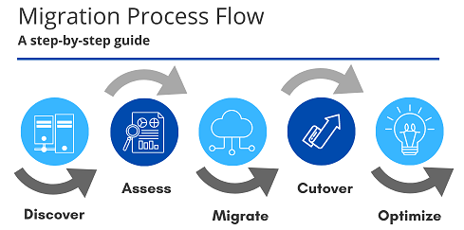
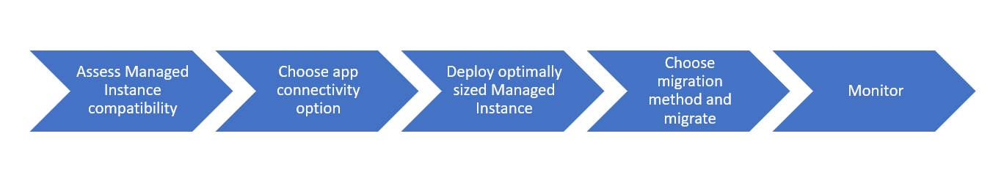
Choosing our target
Azure SQL DB or Managed Instance
Considerations from the previous slide
SKU recommendation
Notes:
What is the current size of the databases?
* Azure SQL DB has size limitations based on the SKU and Tier.
* Azure SQL DB has a max size of 4 TB
* Azure Hyperscale SQL DB has a max size of 100 TB
* Azure MI has a max size of 8 or 16 TB based on its tier
* General Purpose service tier - Azure SQL Database & Azure SQL Managed Instance | Microsoft Docs - https://bit.ly/3BrhRrw
* Business Critical service tier - Azure SQL Database & Azure SQL Managed Instance | Microsoft Docs - https://bit.ly/3BrU1M9
What is the expected growth for the database?
* Determining growth is important as it helps us define which Azure SQL DB we can look at migrating to
* Refer to links provided above for max size limitations of each database and each tier
What is our workload? This can best be determined by executing the following to gather database performance data.
* Get Azure SQL SKU recommendations (Data Migration Assistant) - SQL Server | Microsoft Docs - https://bit.ly/3Uo0Tme
What is out SLA?
* What level of resilience does the database require? Will we require geo-replicated database? Will geo-redundant backups work as a DR model?
* High availability - Azure SQL Database and SQL Managed Instance | Microsoft Docs - https://bit.ly/3qQbt8e
What is the RTO/RPO of the database?
* Azure SQL DB and Managed Instance Provides point in time recovery from the local backups
* Automatic, geo-redundant backups - Azure SQL Database & Azure SQL Managed Instance | Microsoft Docs- https://bit.ly/3QYyFf0
* Note the RPO and RTO capabilities noted in section “Restore capabilities and features of Azure SQL Database and Azure SQL Managed Instance”
Is there any breaking changes found in the DMA ( Database Migration Assistant)
* Is the breaking change in Azure SQL DB can we utilize Azure Managed Instance?
* What will it take to fix the identified breaking change?
Does the database require HA? What is the BCDR plan for the database in question?
High availability - Azure SQL Database and SQL Managed Instance | Microsoft Docs - https://bit.ly/3RVzoz7
Does the database have a reliance on another database within the SQL Server Instance? Does the database/application have a query that spans multiple databases with a single connection?
Is there a reliance on linked servers?
Does the database require SQL Agent jobs outside of scheduled maintenance?
* One possible solution to SQL Agents
* Managed Instances have the ability to deploy SQL Agent Jobs
Does the database require the OS?
* For example are there Stored Procs that make calls to the OS

Slide 11
Tools to help choose our target
Tools available to help evaluate and determine our target
Azure Data Studio
Evaluate breaking changes, compatibility, and SKU recommendations
Can be used to migrate database(s) to Azure SQL MI, Azure Virtual Machines and Azure SQL Database
Data Migration Assistant
Start leveraging ADS with SQL Migration Extension
Evaluate breaking changes, compatibility, and SKU recommendations
Can be used to migrate database(s) to Azure SQL DB

Slide 12
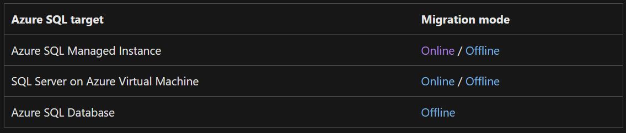
ADS SQL Migration to Managed Instance
ADS SQL Migration Steps
Identify Backup Source Location
Compatibility check
SKU recommendation
Create Data Migration Service
Migration (Online/Offline)
Monitor and Cutover of Migration
Notes:
Azure Data Studio with Azure SQL Migration Extension - https://bit.ly/3SgHguM
https://docs.microsoft.com/en-us/azure/dms/ads-sku-recommend - https://bit.ly/3dow00B
Tutorial: Migrate SQL Server to Azure SQL Managed Instance online using Azure Data Studio - Azure Database Migration Service(DMS) | Microsoft Docs - https://bit.ly/3UmZEnl
Quickstart: Restore a backup (SSMS) - Azure SQL Managed Instance | Microsoft Docs - https://bit.ly/3S17hyn
Custom roles: Online SQL Server to SQL Managed Instance migrations using ADS - Azure Database Migration Service | Microsoft Docs - https://bit.ly/3UoNhHq
https://docs.microsoft.com/en-us/azure/dms/migration-dms-powershell-cli - https://bit.ly/3DxffuN

Slide 13
Demo: Examine Backups Demo : Compatibility check Demo : SKU recommendation Demo : Create Data Migration Service
Daniel

Slide 14
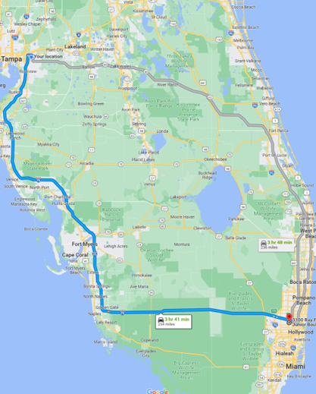
Migration to Azure Managed Instance (MI)
Backup and restore
Log Replay Service (LRS)
Managed Instance Link
Azure Data Studio with Azure SQL Migration Extension ( We will Demo this )
Notes:
Backup and restore - https://bit.ly/3BtPAQS
RESTORE (Transact-SQL) - SQL Server | Microsoft Docs - https://bit.ly/3xzWyCM
Back up to URL best practices & troubleshooting for Microsoft Azure Blob Storage - SQL Server | Microsoft Docs - https://bit.ly/3BMprgD
Backing up a VLDB to Azure Blob Storage | Microsoft Docs - https://bit.ly/3qOL4Yp
Azure Data Studio with Azure SQL Migration Extension - https://bit.ly/3SgHguM
https://docs.microsoft.com/en-us/azure/dms/ads-sku-recommend - https://bit.ly/3dow00B
Tutorial: Migrate SQL Server to Azure SQL Managed Instance online using Azure Data Studio - Azure Database Migration Service(DMS) | Microsoft Docs - https://bit.ly/3UmZEnl
Quickstart: Restore a backup (SSMS) - Azure SQL Managed Instance | Microsoft Docs - https://bit.ly/3S17hyn
Custom roles: Online SQL Server to SQL Managed Instance migrations using ADS - Azure Database Migration Service | Microsoft Docs - https://bit.ly/3UoNhHq
https://docs.microsoft.com/en-us/azure/dms/migration-dms-powershell-cli - https://bit.ly/3DxffuN
Log Replay Service (LRS) - https://bit.ly/3xCBCuZ
Managed Instance Link (Preview) - https://bit.ly/3SeHy5d

Slide 15
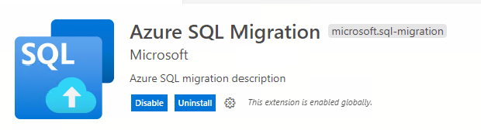
Migration to Azure Managed Instance (MI)
Azure Data Studio with Azure SQL Migration Extension
Migrate to Azure Managed Instance, SQL DB, or SQL Server on Azure Virtual Machine
Step by step wizard: Assessment, Recommendation, Migration
Online and Offline
Powered by Data Migration Service
Leverage self hosted integration runtime to source SQL Server backups on-premises
Automate with PowerShell or Azure CLI (Preview)
Notes:
Azure Data Studio with Azure SQL Migration Extension - https://bit.ly/3SgHguM
https://docs.microsoft.com/en-us/azure/dms/ads-sku-recommend - https://bit.ly/3dow00B
Tutorial: Migrate SQL Server to Azure SQL Managed Instance online using Azure Data Studio - Azure Database Migration Service(DMS) | Microsoft Docs - https://bit.ly/3UmZEnl
Quickstart: Restore a backup (SSMS) - Azure SQL Managed Instance | Microsoft Docs - https://bit.ly/3S17hyn
Custom roles: Online SQL Server to SQL Managed Instance migrations using ADS - Azure Database Migration Service | Microsoft Docs - https://bit.ly/3UoNhHq
https://docs.microsoft.com/en-us/azure/dms/migration-dms-powershell-cli - https://bit.ly/3DxffuN

Slide 16
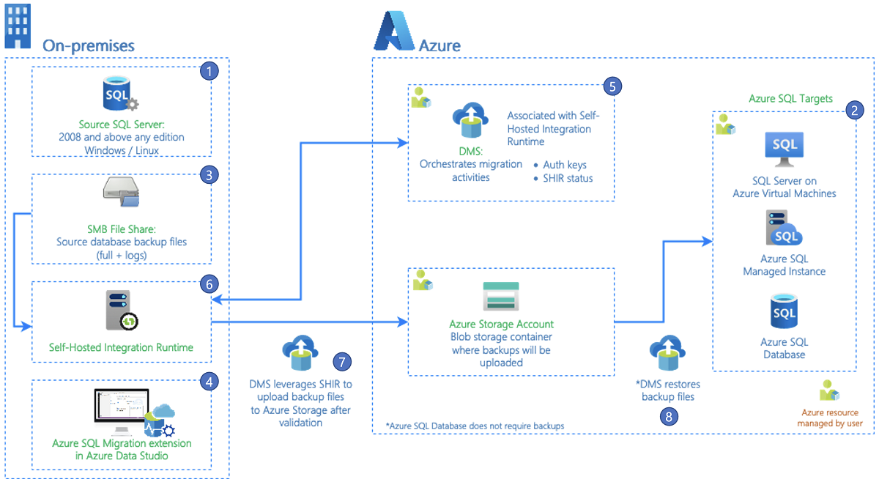
Azure SQL Migration extension for Azure Data Studio
Notes:
Azure Data Studio with Azure SQL Migration Extension - https://bit.ly/3SgHguM
https://docs.microsoft.com/en-us/azure/dms/ads-sku-recommend - https://bit.ly/3dow00B
Tutorial: Migrate SQL Server to Azure SQL Managed Instance online using Azure Data Studio - Azure Database Migration Service(DMS) | Microsoft Docs - https://bit.ly/3UmZEnl
Quickstart: Restore a backup (SSMS) - Azure SQL Managed Instance | Microsoft Docs - https://bit.ly/3S17hyn
Custom roles: Online SQL Server to SQL Managed Instance migrations using ADS - Azure Database Migration Service | Microsoft Docs - https://bit.ly/3UoNhHq
https://docs.microsoft.com/en-us/azure/dms/migration-dms-powershell-cli - https://bit.ly/3DxffuN

Slide 17
ADS SQL Migration to Managed Instance
ADS SQL Migration Steps
Identify Backup Source Location
Create Data Migration Service
Compatibility check
SKU recommendation
Migration (Online/Offline)
Monitor and Cutover of Migration
Notes:
Azure Data Studio with Azure SQL Migration Extension - https://bit.ly/3SgHguM
https://docs.microsoft.com/en-us/azure/dms/ads-sku-recommend - https://bit.ly/3dow00B
Tutorial: Migrate SQL Server to Azure SQL Managed Instance online using Azure Data Studio - Azure Database Migration Service(DMS) | Microsoft Docs - https://bit.ly/3UmZEnl
Quickstart: Restore a backup (SSMS) - Azure SQL Managed Instance | Microsoft Docs - https://bit.ly/3S17hyn
Custom roles: Online SQL Server to SQL Managed Instance migrations using ADS - Azure Database Migration Service | Microsoft Docs - https://bit.ly/3UoNhHq
https://docs.microsoft.com/en-us/azure/dms/migration-dms-powershell-cli - https://bit.ly/3DxffuN

Slide 18
Demo : Migration (Online/Offline) Demo : Monitor and Cutover of Migration
Daniel

Slide 19
Post-Migration

Slide 20
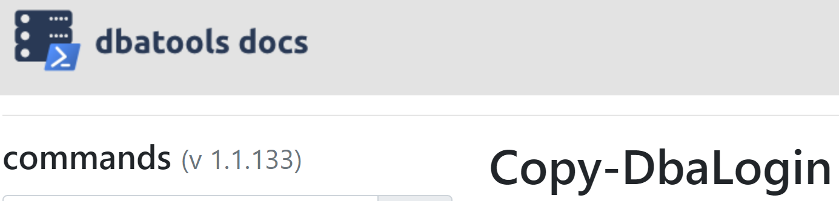
Post Migration Considerations
Logins, Agent Jobs, Maintenance (DBATools, ADS )
Performance considerations
Resiliency / BCDR needs met
Monitoring in place
SQL Insights
Azure Monitor (Managed Instance and SQL DB)
Notes:
MI
SQL Server to Azure SQL Managed Instance: Performance baseline - Azure SQL Managed Instance | Microsoft Docs - https://bit.ly/3BUzKjY
https://docs.microsoft.com/en-us/azure/azure-sql/migration-guides/managed-instance/sql-server-to-managed-instance-guide?view=azuresql#post-migration - https://bit.ly/3dp1xQ6
Microsoft Defender for SQL - Azure SQL Database | Microsoft Docs - https://bit.ly/3qOdim4
https://docs.microsoft.com/en-us/azure/azure-sql/database/monitor-tune-overview?view=azuresql - https://bit.ly/3xBdWHz
The best practices for performance comparison between Azure SQL Managed Instance and SQL Server - https://bit.ly/3dv3dri
Key causes of performance differences between SQL managed instance and SQL Server | Azure Blog and Updates | Microsoft Azure - https://bit.ly/3BwPnfI
Storage performance best practices and considerations for Azure SQL DB Managed Instance (General Purpose) - Microsoft Tech Community
Resource limits - Azure SQL Managed Instance | Microsoft Learn - https://bit.ly/3C79J0A
Azure SQL DB
https://docs.microsoft.com/en-us/azure/azure-sql/migration-guides/database/sql-server-to-sql-database-guide?view=azuresql#post-migration - https://bit.ly/3DyUqPC

Slide 21

Where did our journey take us?
Pre-Migration
Migration
Post-Migration

Slide 22
Helpful Links
Azure Data Studio & the #ADS Migration Extension: A Powerful Combo for Online #SQL MI Migration Pt 1
https://www.youtube.com/watch?v=jsVrACAGyvU&ab_channel=TalesFromTheField
Azure Data Studio & the #ADS Migration Extension: A Powerful Combo for Online #SQL MI Migration Pt 2
https://www.youtube.com/watch?v=rLU8C_YfilU&ab_channel=TalesFromTheField
Azure Data Studio & the #ADS Migration Extension: A Powerful Combo for Online #SQL MI Migration Pt 3
https://www.youtube.com/watch?v=YPOlnv7MW6Y&ab_channel=TalesFromTheField
Azure Data Studio & the #ADS Migration Extension: A Powerful Combo for Online #SQL MI Migration Pt 4
https://www.youtube.com/watch?v=dfpVf8Nc5hw&ab_channel=TalesFromTheField
Azure SQL Virtual Machine Backup to URL, SEPARATION OF DUTIES
https://www.youtube.com/watch?v=IIsEslo2tqw&ab_channel=TalesFromTheField
Tales From the Field Public Github
https://github.com/TalesFromTheField/Team-Presentation/tree/main/2023_SQL_Sat_Orlando/DanTaylor_ADS_Migration_Extension

Slide 24
Questions ?
Thank You!

Slide 25
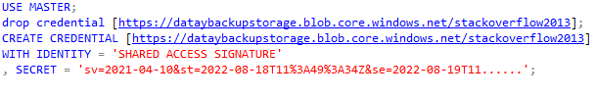
Migration to Azure Managed Instance (MI)
Backup and restore
Backup to URL or Migrate Backup file(s) to blob storage
Restore the database via familiar T-SQL commands
Can only restore a full backup when using T-SQL
Notes:
Backup and restore - https://bit.ly/3BtPAQS
RESTORE (Transact-SQL) - SQL Server | Microsoft Docs - https://bit.ly/3xzWyCM
Back up to URL best practices & troubleshooting for Microsoft Azure Blob Storage - SQL Server | Microsoft Docs - https://bit.ly/3BMprgD
Backing up a VLDB to Azure Blob Storage | Microsoft Docs - https://bit.ly/3qOL4Yp

Slide 26
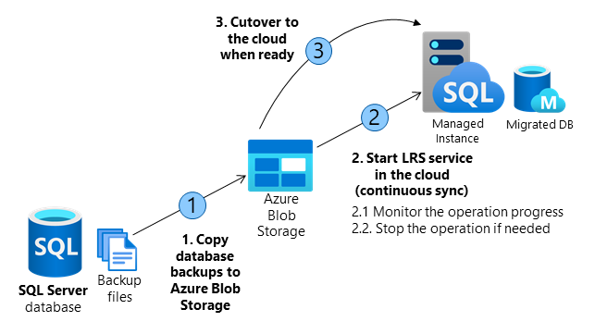
Migration to Azure Managed Instance (MI)
Log Replay Service (LRS)
Each LRS instance is for 1 database
You can have up to 100 LRS sessions active on a Managed Instance at a time LRS accepts Full Backups, Differential Backups, and Log Backups
2 ways to setup LRS
Autocomplete ( once LRS begins no new backups can be added )
Continuous mode is essentially log shipping
No GUI currently to setup
Notes:
Log Replay Service (LRS) - https://bit.ly/3xCBCuZ
You need more control for your database migration project.
There's little tolerance for downtime during migration cutover.
The Database Migration Service executable file can't be installed to your environment.
The Database Migration Service executable file doesn't have file access to your database backups.
No access to the host OS is available, or there are no administrator privileges.
You can't open network ports from your environment to Azure.
Network throttling, or proxy blocking issues exist in your environment.
Backups are stored directly to Azure Blob Storage through the TO URL option.
You need to use differential backups.

Slide 27
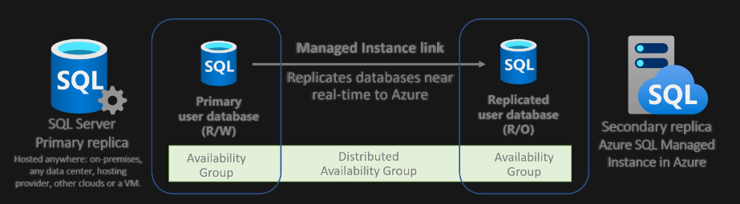
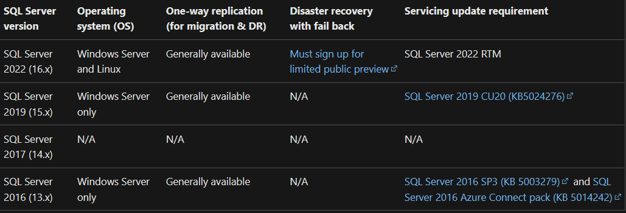
Migration to Azure Managed Instance (MI)
Managed Instance Link (Preview for some solutions)
Connects SQL Servers hosted anywhere to SQL Managed Instance
Minimal downtime migration
True online migration to any Managed Instance service tier
Understand limitations
Notes:
Managed Instance Link - https://bit.ly/3SeHy5d
Understand limitations
One-way replication (SQL Server versions 2016 to 2019 Not Available 2017):
Disaster recovery (SQL Server 2022)
Auto-failover groups aren't supported with instances that use the link feature

Slide 28
Migration to Azure Managed Instance (MI)
Azure Data Studio with Azure SQL Migration Extension
Migrate to Azure Managed Instance, SQL DB, or SQL Server on Azure Virtual Machine
Step by step wizard: Assessment, Recommendation, Migration
Online and Offline
Powered by Data Migration Service
Leverage self hosted integration runtime to source SQL Server backups on-premises
Automate with PowerShell or Azure CLI (Preview)
Notes:
Azure Data Studio with Azure SQL Migration Extension - https://bit.ly/3SgHguM
https://docs.microsoft.com/en-us/azure/dms/ads-sku-recommend - https://bit.ly/3dow00B
Tutorial: Migrate SQL Server to Azure SQL Managed Instance online using Azure Data Studio - Azure Database Migration Service(DMS) | Microsoft Docs - https://bit.ly/3UmZEnl
Quickstart: Restore a backup (SSMS) - Azure SQL Managed Instance | Microsoft Docs - https://bit.ly/3S17hyn
Custom roles: Online SQL Server to SQL Managed Instance migrations using ADS - Azure Database Migration Service | Microsoft Docs - https://bit.ly/3UoNhHq
https://docs.microsoft.com/en-us/azure/dms/migration-dms-powershell-cli - https://bit.ly/3DxffuN

